Slide 1
The Overture II
Later developments

Slide 2
A definition and some synonyms
According to Merriam-Webster the definitions for “overture” are –
1a: an initiative toward agreement or action : PROPOSAL
b: something introductory : PRELUDE
2a: the orchestral introduction to a musical dramatic work
b: an orchestral concert piece written especially as a single movement in sonata form
For our musical overture, the term originated in France, and we will return to it in another presentation. The word has been adopted in English and in German (overture). Mozart continued the use of the Italian term, Sinfonia. Other words used include “Prelude,” and “Vorspiel.” Although the form originated in the theater (2a above), not many years passed before concert works were composed in this form. Their function in concerts was similar, however, serving to begin the concerts or perhaps to introduce the second half of a performance.

Slide 3
Sonata-Allegro Form, a Quick Review
This formal design assumed increasing importance during the transition from the Baroque style to the Classical style. It is sometimes referred to simply as “sonata form,” and sometimes as “first movement” form. There really is not a perfect designation. “Sonata form” can lead to confusion with the totality of a sonata, symphony, or work of chamber music; “sonata-allegro” is not quite satisfactory, since it is sometimes used in slow movements, such as the majority of Mozart’s symphonies, and “first movement form” is likewise not quite ideal, since it is can be used for any movement of a multi-movement work, and is also used for works such as overtures, which have only one movement.

Slide 4
A description of the form
The main body may be preceded by a slow introduction. This introduction is rarely related to the main body of the work.
The main body begins with the exposition
The main body of the form begins with the first “theme.” The theme may or may not be melodic and this section may have more than one musical idea.
The second “theme” area follows and is typically distinguished by contrasting material and a different tonal center.
The exposition concludes with a closing section. This section can be new material, or it may contain ideas from the first theme area. In symphonies and chamber music, the exposition is generally repeated, but not in overtures.

Slide 5
The development follows the exposition
Development sections are usually characterized by varied treatment of some of the material from the exposition and by tonal instability. In overtures, the development section is frequently minimized, although we will see that in some of the concert overtures, the development can be extensive.
The development section leads to the recapitulation, or reprise.
This section is characterized by a re-presentation of the material in the exposition, more or less literally, and by an emphasis on the home key.
Finally, the work will typically conclude with a coda.
The coda can be just a brief, brilliant flourish, or it may be more extensive, taking on the character of a second development.

Slide 6
Other types of Overtures
Sonata-allegro is not the only formal structure associated with theatrical overtures.
A common type is the “medley” overture, in which material from the opera or ballet is presented in the overture as a kind of foreshadowing.
Some well-known and popular overtures that use this technique are
Die Fledermaus by Johann Strauss
The Sicilian Vespers by Giuseppe Verdi
Pirates of Penzance by W. S. Gilbert
Most overtures of Broadway Musicals
Some composers combine the two techniques by weaving melodies from the main work into a sonata-allegro structure
Particularly fine examples of this type are
Der Freischutz by Carl Maria von Weber
The Merry Wives of Windsor by Otto Nicolai

Slide 7
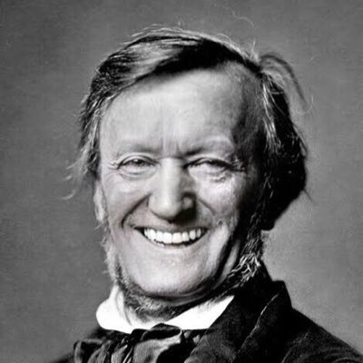
Richard Wagner (1813-1883)
Envisioned his “music dramas” to be the logical successors to Romantic symphony, especially those of Beethoven.
Die Meistersinger von Nürnberg (1867) is his only mature work based in history rather than myth, and his only mature comedy.
The overture is a different sort of “medley” overture in that it states themes from the opera, and then combines them in a contrapuntal texture similar to that of the orchestral music in his operas.

Slide 8
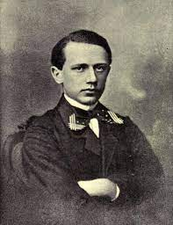
Pyotr Ilyich Tchaikovsky (1840-1893)
Romeo and Juliet was initially based on the true story of two 14th century Veronese lovers. Shakespeare apparently found the story in a 1562 poem by Arthur Brooke.
Tchaikovsky’s Romeo and Juliet: Fantasy Overture (1869-1886) had a very difficult creation. The young Tchaikovsky was guided and critiqued rather sternly by his older colleague Mily Balakirev, who was an influential figure in the emerging Russian nationalist music movement.
The initial work was entitled Fatum, but bears little resemblance to the work we now know. It underwent two sets of revisions.
Tchaikovsky did not provide a program for the work, leaving the creation of a program for each listener.

Slide 9
Romeo and Juliet Analysis
Romeo and Juliet shares many of the characteristics of earlier concert overtures, but is different in many respects as well. Its overall length of ca. 20 minutes is about twice as long as typical overtures, and almost as long as some mature classical symphonies. Consequently, it rarely functions as the opening of a concert.
Characterized by an unusually long slow introduction (ca. 5:00), an unusually extensive development section, and an equally extended coda (ca 4:30)
The introduction opens with the “Friar Laurence” theme, but contains hints of the all the material in the main section, both the “Montagues and Capulets” theme and the “Romeo and Juliet” theme. Tchaikovsky did not give names to these themes.
In my view, the overture does not attempt to follow the narrative structure, but seeks to characterize the essence of the dramatic conflict. The coda is perhaps the most distinctly narrative of any of the sections.

Slide 10
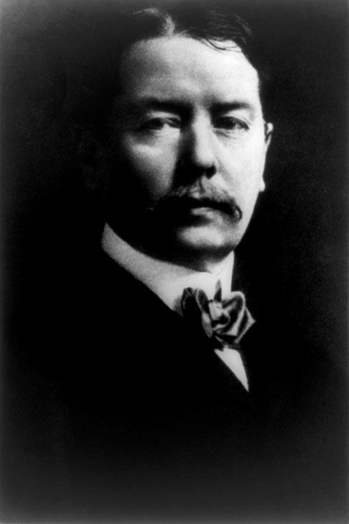
George Whitefield Chadwick (1854-1931)
Chadwick is usually associated with the Second New England School of composers. The First New England School was comprised of musicians from the late colonial and early republican periods of US history. Perhaps the best known is William Billings.
The Second New England School created the first substantial body of orchestral music originating in the US. It has been unduly neglected, including by me.
Other members of this school include John Knowles Paine, Horatio Parker, Amy Beach, Arthur Foote, Edward MacDowell.
Rip van Winkle overture was composed in 1879 as a kind of graduation piece from the Leipzig Conservatory.

Slide 11
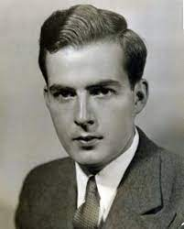
Samuel Barber (1910-1981)
Samuel Barber was one of the most widely acclaimed and well-loved of American composers.
He is considered an exponent of 20th century Neo-Romanticism, and was never involved with some of the more adventuresome experiments in 20th century composition.
His purely instrumental works comprise less than half of his total library.
His School for Scandal Overture, Op. 5 was composed in 1931 while he was still a student at the Curtis Institute.

Slide 12
Many others
The Overture genre seems to have brought out the best in many composers. The quality of comparative brevity has also made it a popular genre with concert audiences. Some other exceptional overtures not previously mentioned include the following:
Carnival Overture – Antonin Dvorak
Cockaigne Overture – Edward Elgar
Cuban Overture – George Gershwin
Festive Overture- Dmitri Shostakovich
Hamlet Overture – Peter I. Tchaikovsky
Outdoor Overture – Aaron Copland
Overture on Hebrew Themes – Sergei Prokofiev
Russian Easter Overture – Nicolai Rimsky-Korsakov
Enjoy!!

